Slide 1


Introduction to ATM
Civil Aviation University of China
Civil Aviation University of China
Lesson 1

Slide 2
Learning Objectives
List the characteristics of Air traffic
List the three categories of air traffic
State the objective of ATM
List the three components of ATM
List the three categories of ATM infrastructures

Slide 3
Characteristics of Air Traffic
Air Traffic, as compared to road traffic,
No fixed “road” is required
3 dimensional
Much faster
Unable to standstill, limited with speed range
Which means air traffic,
Must be channelized - Airways
Should be allocated with levels – Flight levels
Needs larger separation, should be provided with separation – ATC
Should be provided with Flow control - ATCFM

Slide 4
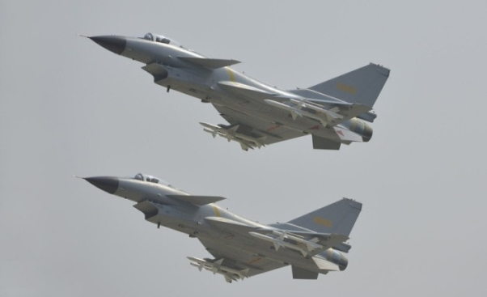
Types of Air Traffic
Commercial air traffic – Safety, Regularity
Military air traffic – Priority?
General Aviation Traffic (GA) – accessibility
General Air Traffic (GAT)
all flights conducted in accordance with the rules and procedures of ICAO and/or the national civil aviation regulations and legislation. GAT can include military flights for which ICAO rules and procedures satisfy entirely their operational requirements.
Operational Air Traffic (OAT)
encompasses all flights which do not comply with the provisions stated for GAT and for which rules and procedures have been specified by appropriate national authorities. OAT can include civil flights such as test-flights, which require some deviation from ICAO rules to satisfy their operational requirements.

Slide 5
ATM
Air traffic management is the dynamic, integrated management of air traffic and airspace safely, economically and efficiently through the provision of facilities and seamless services in collaboration with all parties
ATM is consisting of a ground part and an air part, both of which are needed to ensure the safe and efficient movement of aircraft during all phases of operation.
The execution of ATM calls for a close integration of the ground part and the air part through well-defined procedures.
The ATM system is a system that provides air traffic management through the collaborative integration of humans, information, technology, facilities and services, supported by air, ground and/or space-based communications, navigation and surveillance.

Slide 6
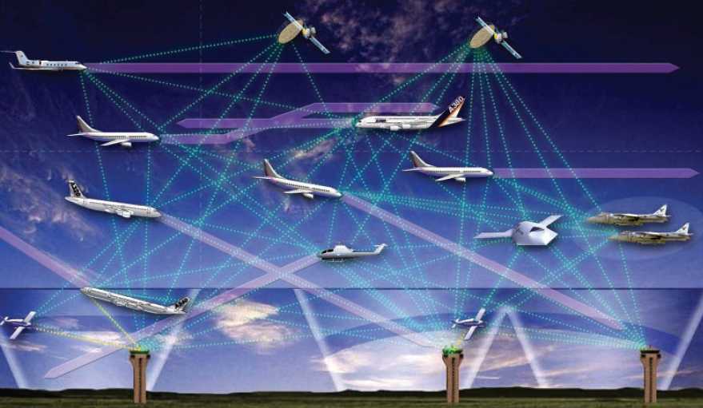
The Objective of ATM
to enable aircraft operators to meet their planned times of departure and arrival and adhere to their preferred flight profiles with minimum constraints and without compromising agreed levels of safety.

Slide 7
Components of ATM
Air Traffic Management
Airspace Management
Air Traffic Capacity &
Flow Management
Air Traffic Services

Slide 8
Information Management for ATM
Airline Operations Centre
Weather Service
Military
Weather
Information Management
Infrastructure status
Aircraft state (Position, velocity, intent)
Historical schedules New flight plans
User preferences
Navigation
Special
user
requests
Resource Allocation
(airspace, routes, etc.)
Proposed Trajectories
4-D Trajectories
Airspace Management
Flow Management
Proposed flight plans
Traffic Management
Separation Management
Handoff
Coordination
Aircraft
Approve/ reject RQ
Loading estimates
Approved/Rejected flight plans
Approved/Rejected Trajectories
Request airspace
Reroute request
Request airspace, routes
Request airspace, separation criteria
Capacity limits (region, airport, sector)
Aircraft state (position, velocity, intent)
Surveillance

Slide 9
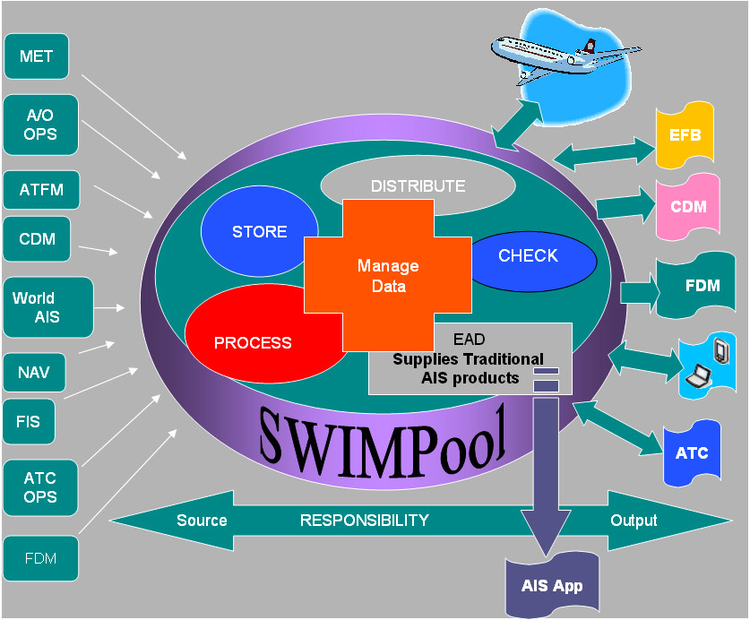
System-Wide Information Management

Slide 10
System-Wide Information Management
The SWIM network will be an IP based data transport network, using proven information communication technology. It will replace the current point to point data systems with a ground/ground communications network which connects all ATM partners; ANSPs, airports and airspace users, including the military. Aircraft will become travelling nodes in the network, permanently connected by a new high capacity air/ground data link.
Using the SWIM network, all partners (in the air and on the ground) will become both consumers and producers of information, which they will share, tailored to their individual needs. This will allow them to make decisions based on full knowledge of accurate up-to-date information and to put back into the system the results of their decisions for others to use.

Slide 11
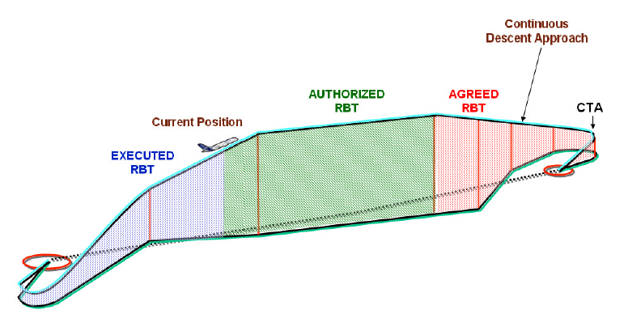
Reference Business Trajectory
RBT – Reference Business Trajectory
CTA – Controlled Time of Arrival
Notes:
RBT – reference business trajectory – the business trajectory which the airspace user agrees to fly and the ANSP and airports agree to facilitate (subject to separation provision). Business trajectory is the representation of an airspace user’s intention with respect to a given flight.
CTA – controlled time of arrival (sometimes referred to as constrained time of arrival) – an ATM imposed time constraint on a defined merging point associated to an arrival runway;

Slide 12
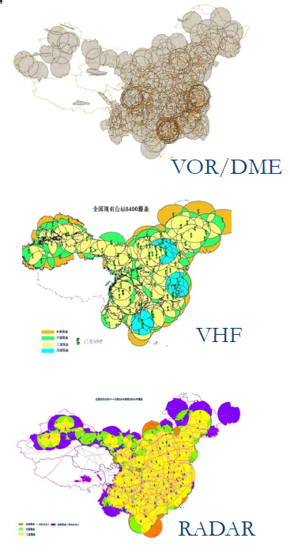
ATM Infrastructures
Communication
Air-GND: HF/VHF/Satellite, voice/data link
GND-GND: AFTN/Telephone, internet/Satellite
Navigation
Ground-based: VOR/DME, ILS
GNSS
Surveillance
Radar
ADS
Notes:
Aeronautical fixed telecommunication network (AFTN). A worldwide system of aeronautical fixed circuits provided, as part of the aeronautical fixed service, for the exchange of messages and/or digital data between aeronautical fixed stations having the same or compatible communications characteristics.

Slide 13
ATM Organizations in China
State Council
Military commission
MoT
General Staff
ATM commission
CAAC
Air Force
ATM Office
Flight control centers
ATMB
Regional ATMBs
ATM Sub-Bureaus & Stations

Slide 14
Challenges for ATM
Safety
Capacity
Efficiency
For airline operations
For ATC operations

Slide 15
Questions
What are the characteristics of air traffic as compared to other traffic?
What are the components of ATM?
What are the infrastructures of ATM?
What the three major categories of air traffic?

